Slide 1
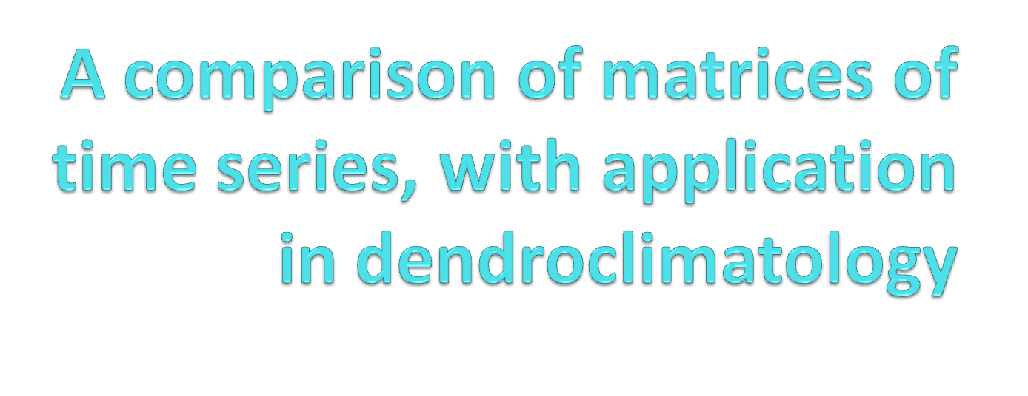
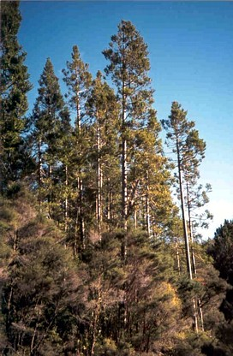
Maryann Pirie
PhD candidate
Department of Statistics and
School of Environment
University of Auckland
Biometric Conference 2009, Taupo

Slide 2
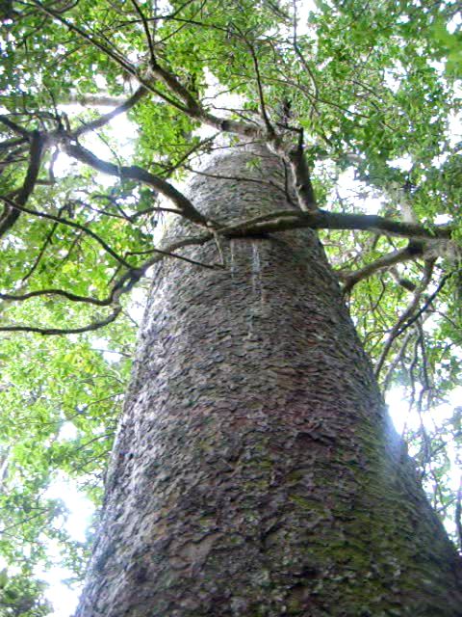
Overview
Key question
Data sets
Developing the methods
Conclusions from simulations
Application to tree-ring
dataset
Biometric Conference 2009, Taupo
Notes:
Dendroclimatology= study of trees
Trees produce annual growth rings which are dependent on climatic conditions
Kauri
located Northern nz
kauri wide ring = cool and/or dry
Narrow ring = warm / wet
ENSO = el nino southern oscillation = global coupled ocean – atmosphere phenomenon centered over the tropical pacific ocean = influences global climates.
Two phases
= el nino: cool-dry northern nz
= la nina warm-wet
Kauri ENSO signal
Note: different that what one would expect, possible reasons include: sunlight, or soil moisture

Slide 3
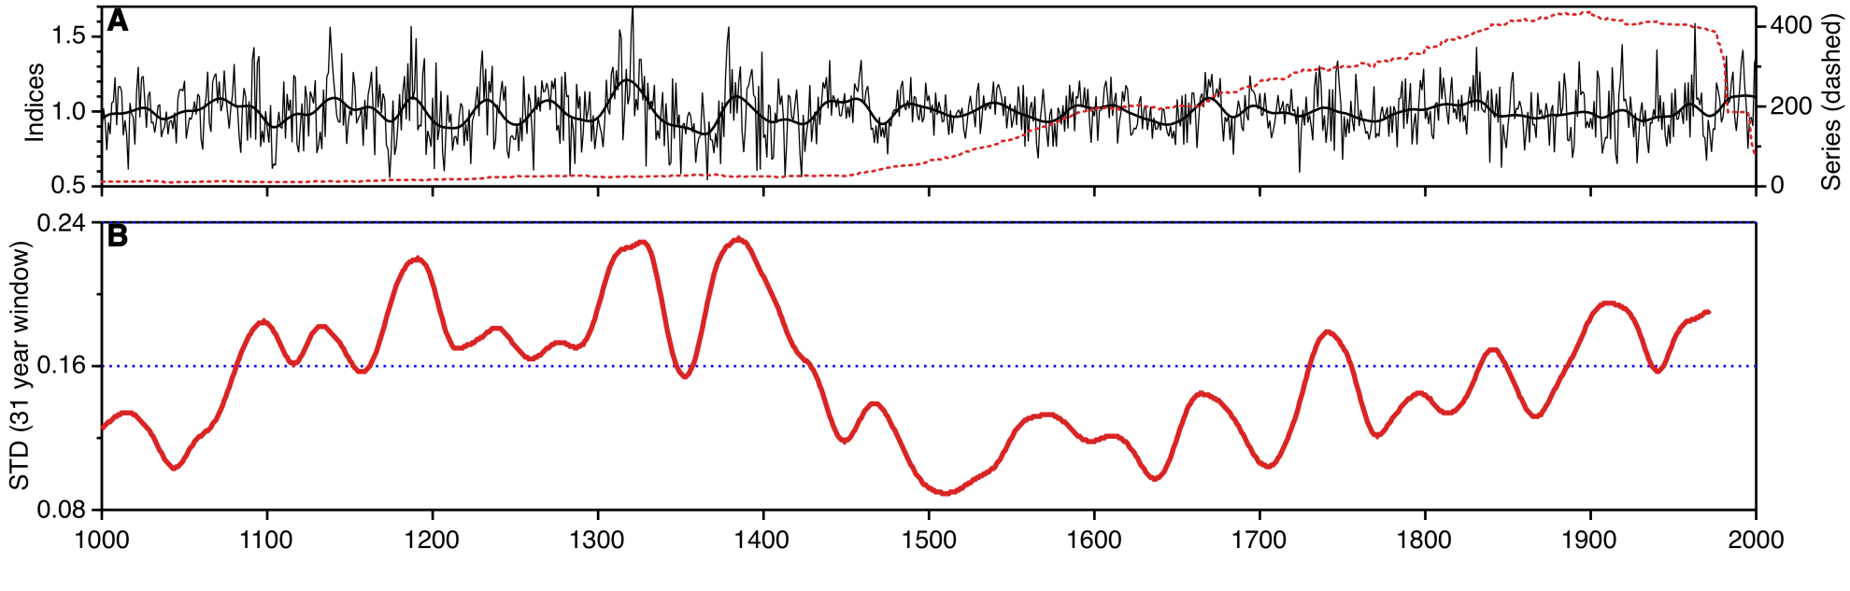
The key question:
To investigate a possible failure of the uniformitarianism principle in the use of kauri
ring-widths to investigate past climates
Contains rings from the inner of the core, formed when tree was smaller
Contains rings from the outer of cores, formed when tree was larger
Biometric Conference 2009, Taupo
Notes:
Top plot = x axis = time
Y axis left = indices
master chronology indices
Each series standardized to remove individual growth trend
Then averaged to produce master
Red dashed sample depth = y axis = number of series 0-400
Max at present
Min back in time
Bottom plot = running standard deviation = y axis standard devation
Measure of ENSO activeness
Low std 1500 = low enso activeness
High std present = high enso activeness
1500 contains rings from inner part of core
Present from the outer part
Thus, concerns that climate response maybe influenced by the size of tree at formation of the ring.
Failure of uniformitarianism principle
That physical and biological processes which link today's environment with today's variation in tree growth must have been in operation in the past
It is possible that the climatic signals become different with increasing size of the tree, or the sensitivity to a specifid climatic variable changes

Slide 4
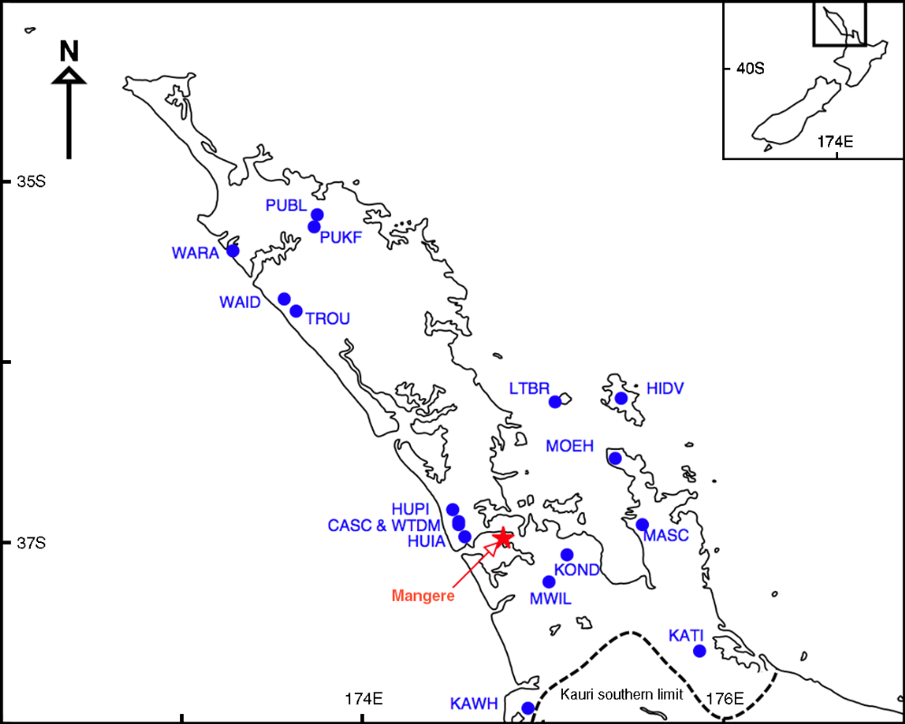
Data
Biometric Conference 2009, Taupo
Notes:
Kauri data sites
Weather station = mangere
Focus on Huapai scientific reserve, west of Auckland.
Large and small trees sampled
Many cores taken

Slide 5
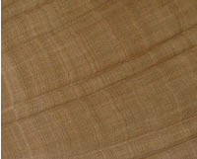
Methods
For a given core we have a series of ring widths,
w_{ijt} t = 1, … , T
We may have several cores from the same tree,
j = 1, … , C_{i} – typically C_{i} = 2
We have many trees, i = 1, … , L
Biometric Conference 2009, Taupo
Notes:
Spend less time
Show core
For each core ring widths are measured, and dated
Need 2 cores to apply dates to the series, as can get missing or false rings
t = 1,..., T ; 1 = inner most ring- ring closest to the centre of the tree
T – outer most ring – ring closest to the bark

Slide 6

Method-issue
Assemble series into an array W is an array with elements w_{ijt} :
Problem: not all series are the same length
Biometric Conference 2009, Taupo
Notes:
Start and end with different dates

Slide 7
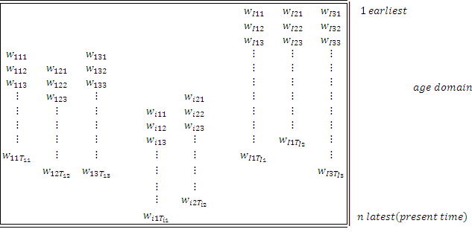
Method-issue
Tree 1
Tree i
w_{ijt} = width _{tree, core, index}
Biometric Conference 2009, Taupo
Notes:
Reality we have a ragged array of time series

Slide 8


Method-issue
Assume times T_{ij} are all equal,
We have two matrices of time series, X,Y
Where X,
For each time we average
To give:
And, for a similar matrix of time series for Y
Biometric Conference 2009, Taupo
Notes:
Assuming array is not a ragged array,
Ie all series start and finish at the same date
Two matrics,
In our application X = proportion of ring widths series formed when tree was small
Y = proportion of ring widths series formed when tree was large.
Average for each time = average each row of matrix
Gives mean series with respect to time.
Repeat for matrix Y, to get mean series with respect to time for y
Series are ‘master chronologies’ ie represent common signal for matrices

Slide 9
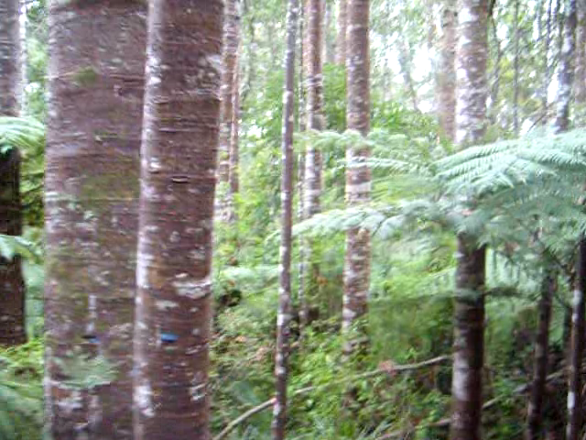
Statistical Question
How do we formalise the difference between the two series;
  and ?
  This will be termed the concordance
  These are not stationary series
  We do not want to use correlation coefficients
Biometric Conference 2009, Taupo
Notes:
Interested in overall similarity of matrices
But also want to know if there are periods of greater similarity or dissimilarity
Interested in the within and between matrices variations. And correlation coefficients do not allow for the within matrix variation.

Slide 10
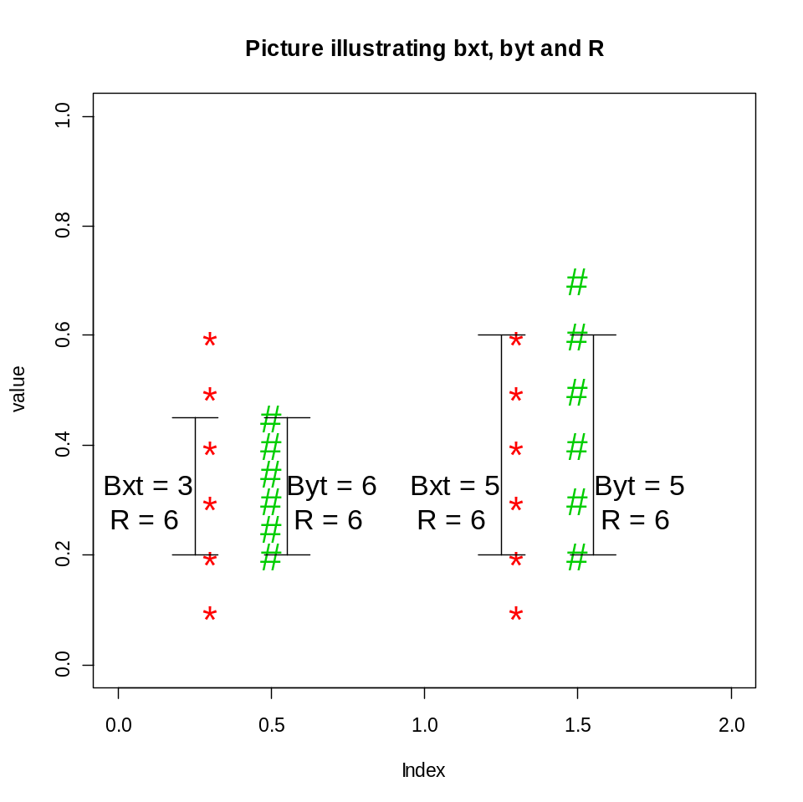

Method-idea for the common period m=n
Produce bootstrapped replicates of:
For each time, t sort the averaged bootstrapped time series,
Count the number of bootstrap replicates that overlap at each time, t
Biometric Conference 2009, Taupo
Notes:
Take time to explain
Using bootstrapping, as at certain times there are small numbers of time series
Also, distribution of matrices unknown
Bootstrapped replicates = randomly select time series to produce bootstrapped matrices
Average these matrices to produce bootstrapped mean series
For each time sort the bootstrapped mean series
Overlap; number of bootstrapped replicates form x that overlap y
And the number from y that overlap x
For example … picture
0.5 arbitrary

Slide 11

Concordance, P
The concordance at time, t, can be defined as:
ρ_{t} lies between 0 and 1
The overall concordance of how similar the two time series
  Combines concordances for all (common) times.
Biometric Conference 2009, Taupo
Notes:
Rt lies between 0 and 1 – 0 no overlap at all 1, complete overlap.
As Rt goes from 0 to 1, matrices move from more different to less different
Limiting behavior of P
Shift in mean
As Bxt goes to R and Byt goes to R , Rt goes 1, thus as overlap increases Rt goes to 1
Shift in Sd (check code)
bxt goes to 1 and byt goes to 0 , thus Rt goes to 0.5.
Issues: Series have been standardized to remove growth effects, - we could do a hierarchical decomposition and check within tree, between tree within site, and between site components of concordance.
Modify this to be > 0.5.
Why 0.5? Arbitrary

Slide 12
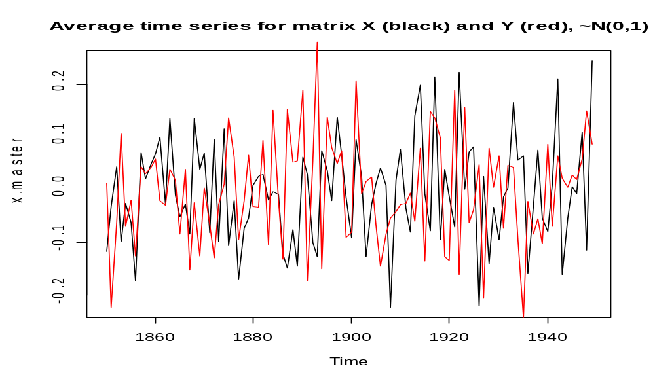
Simulated Results –
Time series generated from normally distributed white noise
Biometric Conference 2009, Taupo
Notes:
Both matrices contain time series that are white noise with same mean and std
Expect them to be similar
Figure 8 Average time series for two matrices of time series X (black) and Y (red), where both of these matrices contain 100 time series of length 100 generated from the normal distribution with mean 0 and SD 1.
Figure 9 shows the shorted bootstrapped replicates for the first 20 series, For the two data matrices being compared, X (red) and Y(red). In this case X and Y ~N(0,1)
Figure 10 shows the frequency of number of times the bootstrapped replicates from: matrix X~N(0,1) overlaps those from matrix Y~(0,1) (Panel A) and matrix Y overlap those from matrix X (panel B). Along the x-axis is the number of bootstrapped replicates that overlap.
Figure 11 the precision index for each time period, where X~N(0,1), and Y~N(0,1). This shows how similar two matrices of time series are. A precision of 1 suggests matrices of time series are similar and a precision of 0 suggested that they are different.

Slide 13
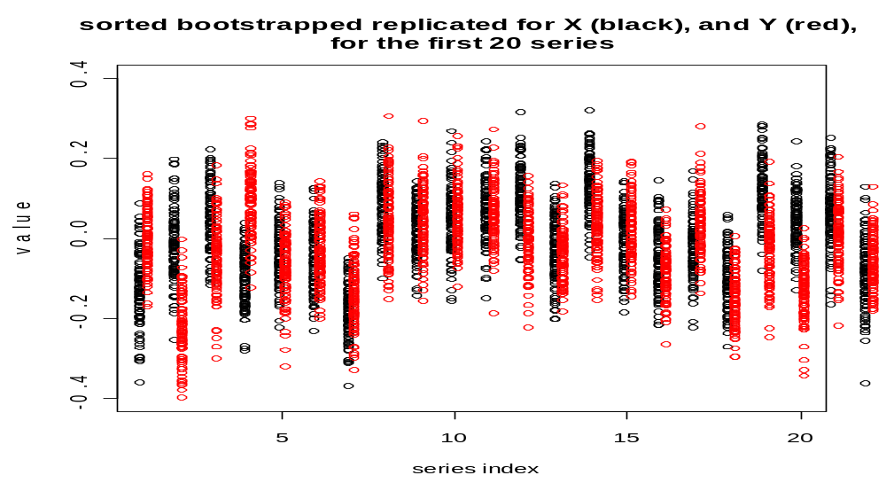
Simulated Results –
Time series generated from normally distributed white noise
Biometric Conference 2009, Taupo

Slide 14
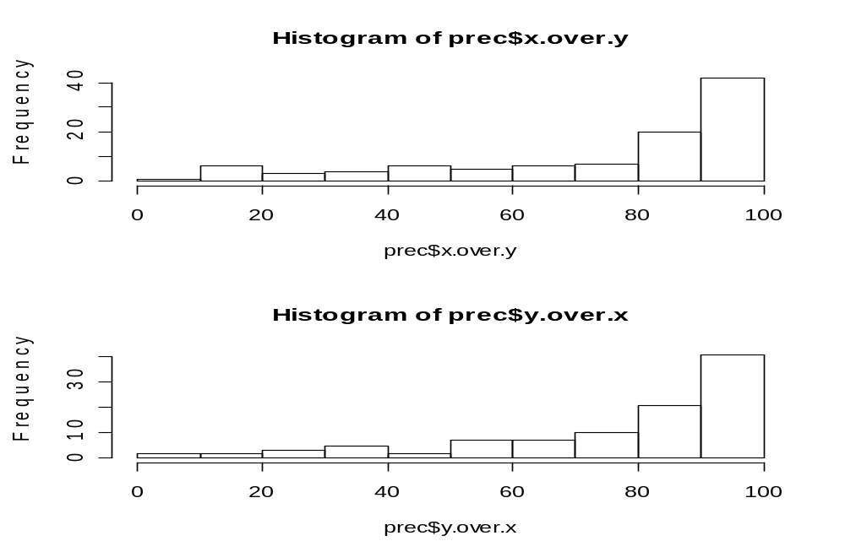
Simulated Results –
Time series generated from normally distributed white noise
Biometric Conference 2009, Taupo
Notes:
Both matrices contain time series that are white noise with same mean and std
Expect them to be similar
Figure 8 Average time series for two matrices of time series X (black) and Y (red), where both of these matrices contain 100 time series of length 100 generated from the normal distribution with mean 0 and SD 1.
Figure 9 shows the shorted bootstrapped replicates for the first 20 series, For the two data matrices being compared, X (red) and Y(red). In this case X and Y ~N(0,1)
Figure 10 shows the frequency of number of times the bootstrapped replicates from: matrix X~N(0,1) overlaps those from matrix Y~(0,1) (Panel A) and matrix Y overlap those from matrix X (panel B). Along the x-axis is the number of bootstrapped replicates that overlap.
Figure 11 the precision index for each time period, where X~N(0,1), and Y~N(0,1). This shows how similar two matrices of time series are. A precision of 1 suggests matrices of time series are similar and a precision of 0 suggested that they are different.

Slide 15
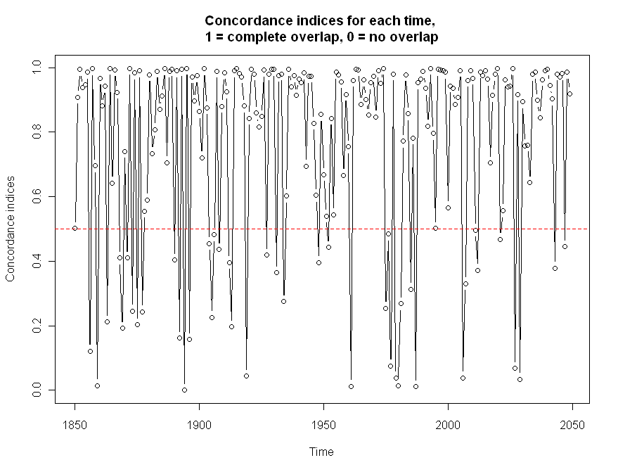
Simulated Results –
Time series generated from normally distributed white noise
Biometric Conference 2009, Taupo
Notes:
Both matrices contain time series that are white noise with same mean and std
Expect them to be similar
Figure 8 Average time series for two matrices of time series X (black) and Y (red), where both of these matrices contain 100 time series of length 100 generated from the normal distribution with mean 0 and SD 1.
Figure 9 shows the shorted bootstrapped replicates for the first 20 series, For the two data matrices being compared, X (red) and Y(red). In this case X and Y ~N(0,1)
Figure 10 shows the frequency of number of times the bootstrapped replicates from: matrix X~N(0,1) overlaps those from matrix Y~(0,1) (Panel A) and matrix Y overlap those from matrix X (panel B). Along the x-axis is the number of bootstrapped replicates that overlap.
Figure 11 the precision index for each time period, where X~N(0,1), and Y~N(0,1). This shows how similar two matrices of time series are. A precision of 1 suggests matrices of time series are similar and a precision of 0 suggested that they are different.

Slide 16
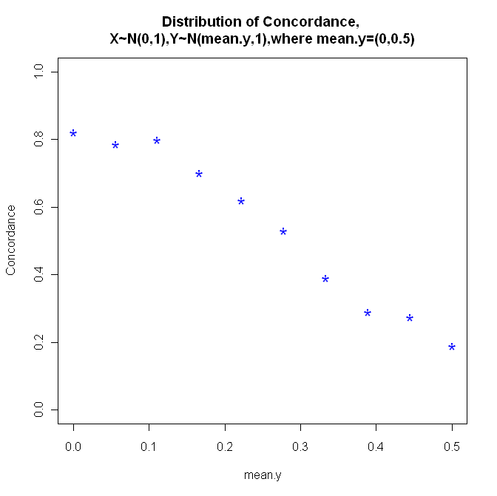
Normally distributed time series
- Differences in level
Biometric Conference 2009, Taupo
Notes:
Mean.y = 0 , both matrices have time series generated from normal distribution with mean 0 and sd 1
Thus similar
Mean.y = 0.5, x has time series generated from normal with mean 0 and sd 1, where as y has time series generated from normal with mean 0.5 and sd 1
Thus dissimilar
Concordance close to 1 = high overlap of bootstrapped replicates, thus similar
Close to 0 = little or no overlap of bootstrapped replicates, thus dissimilar
Drop off from ~ 0.8 down to ~ 0.2
Gives us the null behaviour of our statistic.
Points bigger, cex = 2, pch = “*”, col = 4 (or 2)
When there is little or no overlap tends to ~ 0, high overlap tends to ~1.

Slide 17
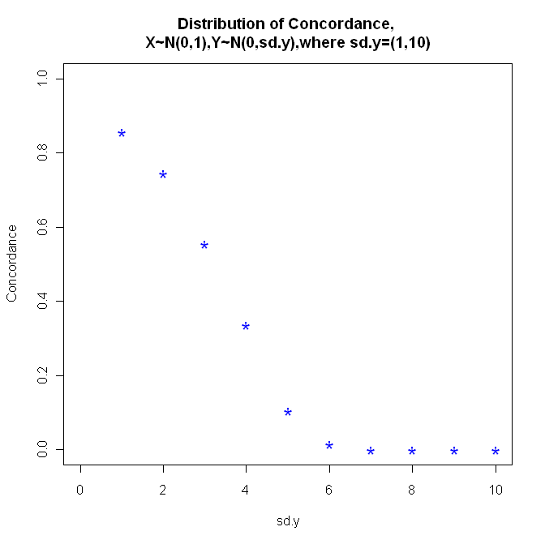
Normally distributed time series - Difference in scale
Biometric Conference 2009, Taupo
Notes:
If have same variance then concordance close to 1
If have different variance then concordance tend to 0
Swap
As variability increases this increases the chances of overlap.
[Not smooth because our simulations not big enough] – but if we put it on the scale of 0,1

Slide 18
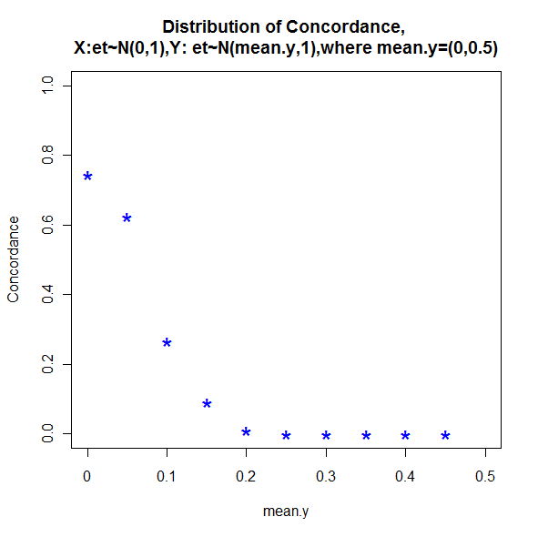
Correlated time series
- Differences in level
Biometric Conference 2009, Taupo
Notes:
In tree ring data there is autocorrelation within the series.
Getting closer to real data. – detects mean shifts more readily – attack key question of uniformitarianism.
Can also check effect of differences of scale

Slide 19
Other design issues
Sensitivity to sample size
Ragged arrays
  Adjust the overlap counts b_{xt}, b_{yt} to proportions
Biometric Conference 2009, Taupo
Notes:
The overall concordance statistic is able to detect if there is a difference between the matrices of time series
The concordance indices allow specific periods of difference/similarities to be identified

Slide 20
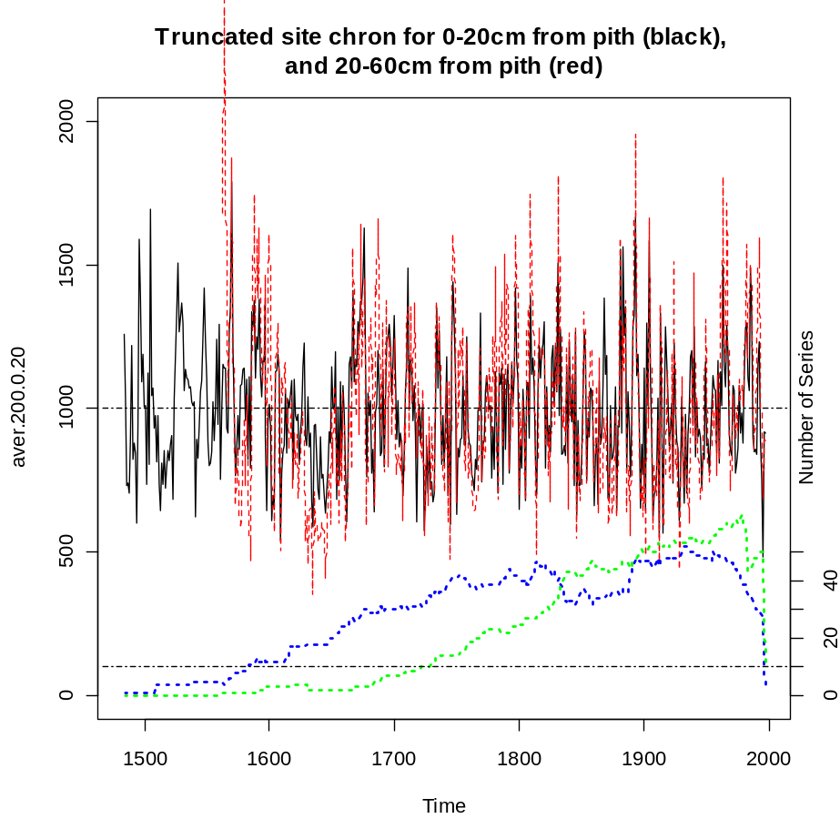
A case study: Tree ring analysis using kauri from Northern New Zealand
Biometric Conference 2009, Taupo
Notes:
The above methods are applied to two subgroups of standardised ring widths time series from a kauri site in Northern New Zealand (Huapai) to determine if these subgroups are different. The dataset from Huapai was divided into two groups. The first group contain the standardised ring widths within 20cm from the estimated centre of the tree, thus this dataset contain the standardised ring widths formed when the trees were ‘small’. The second group contains the standardised ring widths from 20-60cm from the estimated centre of the tree, thus this dataset contains ring widths formed when the trees were ‘large’ . The averaged series for each of these datasets is shown in Figure 52 and a reduced period from 1750-200 is shown in Figure 53, from these plot it appears to be greater variation in the averaged standardized ring widths in the 20-60cm dataset compared to the 0-20cm dataset. Carrying out the above analysis on the period 1750 to 2000, produces an overall precision statistic of 0.38, this indicates that the two dataset are different (referring to Figure 22, an overall statistic less than 0.3, indicated that the two matrices could have the same mean, and greater than 0.3 was an indication that they had different means).
The precision indices revealed that there were some periods where the two datasets were similar, Figure 54. Some noticeable periods were from ~1830-1860, where most of the precision indices are close to 1, indication that there is no difference between the datasets, the overall precision statistic for this period (1830-1860) is 0.22, which indicates that the two datasets are similar for the period 1830-1860. For the period from 1800-1899, the overall precision statistic is 0.29, compared to the period 1900-1999 where the overall precision statistic is 0.44. This suggest that during the 1800’s there is no detectable difference between the dataset, were as during the 1900’s a difference was detected. Why choose 0-20 and 20-60cm? maybe other studies?.

Slide 21
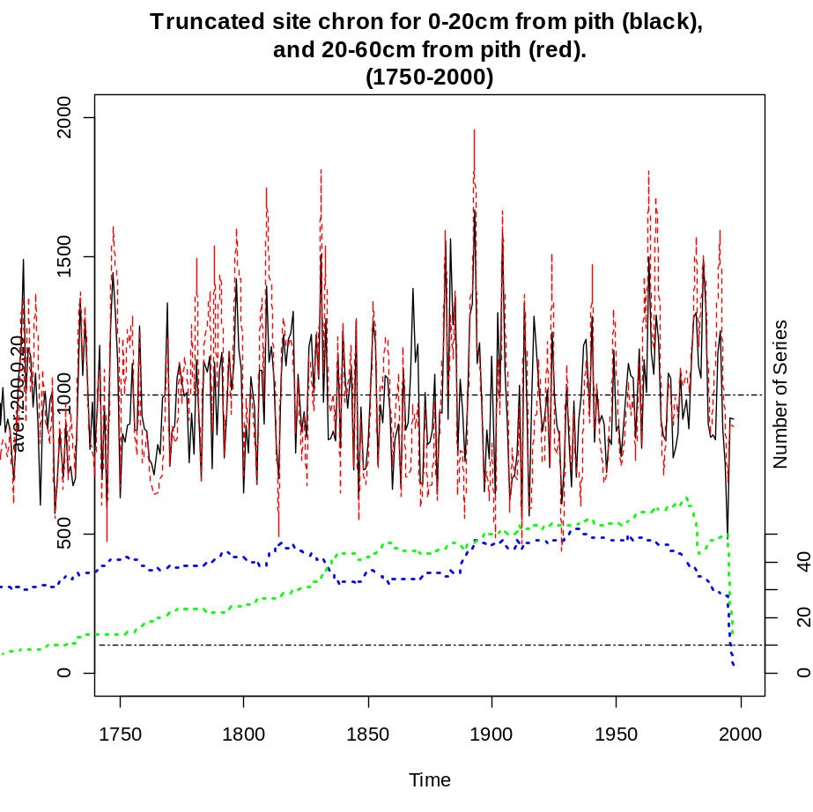
A case study: Tree ring analysis using kauri from Northern New Zealand
Biometric Conference 2009, Taupo
Notes:
Update these plots

Slide 22
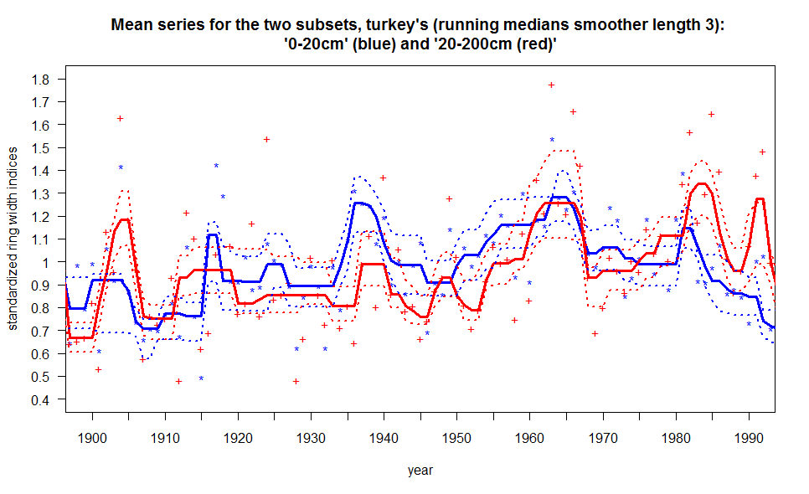
A case study: Tree ring analysis using kauri from Northern New Zealand
Two subsets: small = 0-20cm from pith, large = 20-200cm from pith
Biometric Conference 2009, Taupo
Notes:
Tukey not turkey
Smoothed average series for the two subsets small and large
Pith = biological centre of the tree, in most cases this is estimated as core scarcely pass this centre
95% bootstrapped CI – small number of series ~20 in subset small

Slide 23
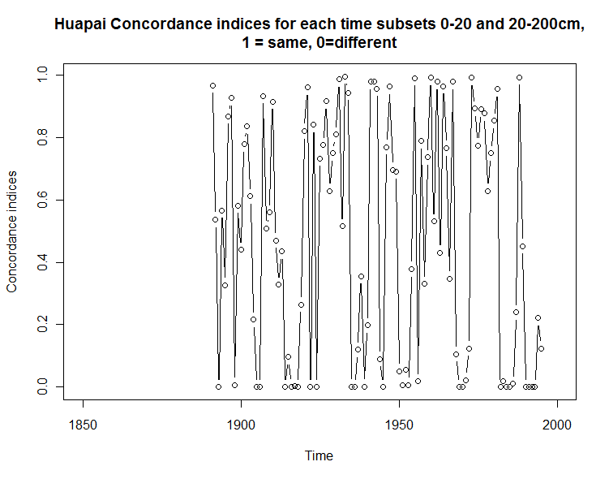
Concordance indices
Biometric Conference 2009, Taupo
Notes:
Overall concordance = 0.5619
Periods of no overlap = concordance near 0
1910, 1930, 1980
Periods of complete overlap = concordance near 1
1920, 1960 and 1970
overall Concordance 0.56, suggesting a difference between the two subsets

Slide 24
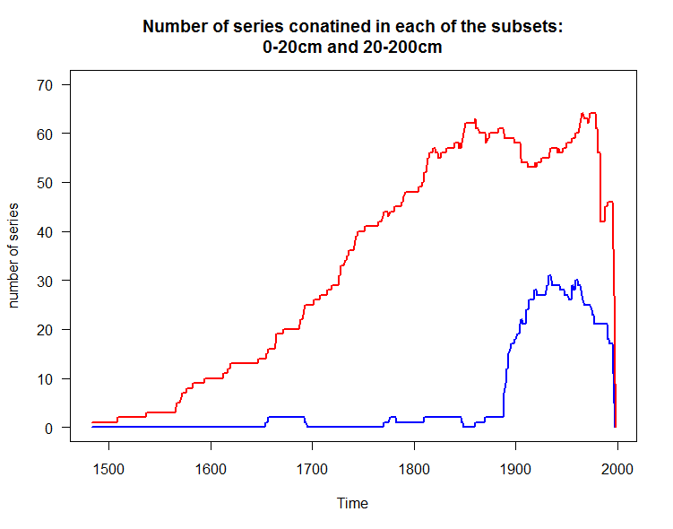
Biometric Conference 2009, Taupo

Slide 25
Conclusion
Concordance indices are able to identify periods of similarity/dissimilarity between two matrices of time series
The Concordance tends to zero when there is little or no overlap between matrices of time series
There was a difference detected between the subsets ‘small’ and ‘large’ for Huapai
Suggesting failure of uniformitarianism principle
Biometric Conference 2009, Taupo

Slide 26
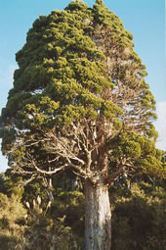

Thank you
Questions/comments
Biometric Conference 2009, Taupo

